Slide 1
PowerPoint Presentation
ON
Project
World Population Analysis
By : Anmol

Slide 2
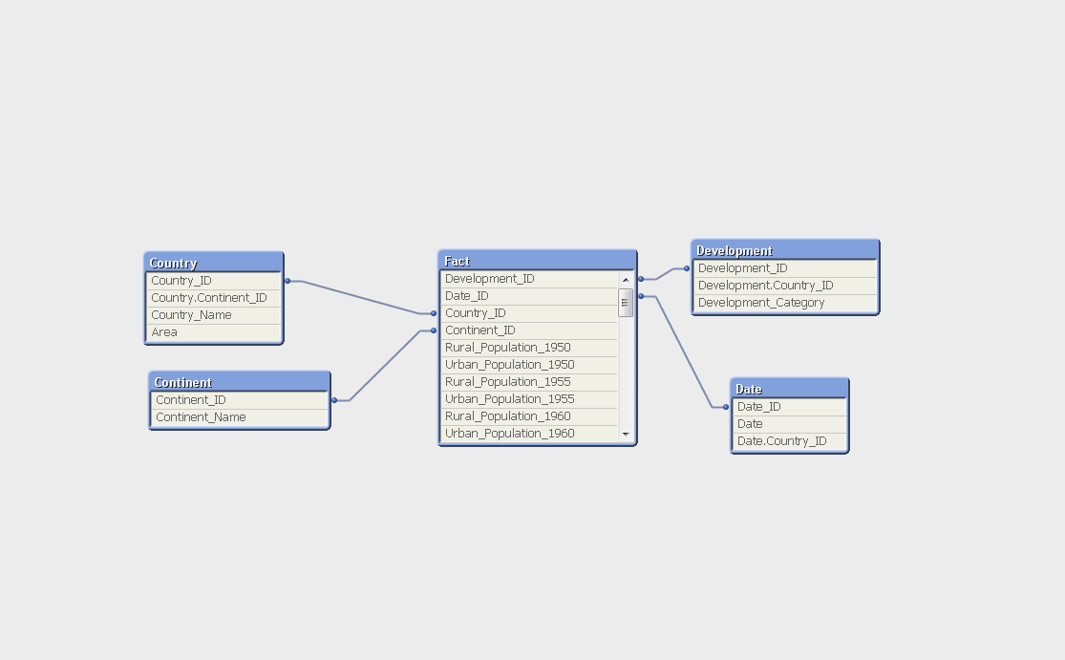
Schema

Slide 3
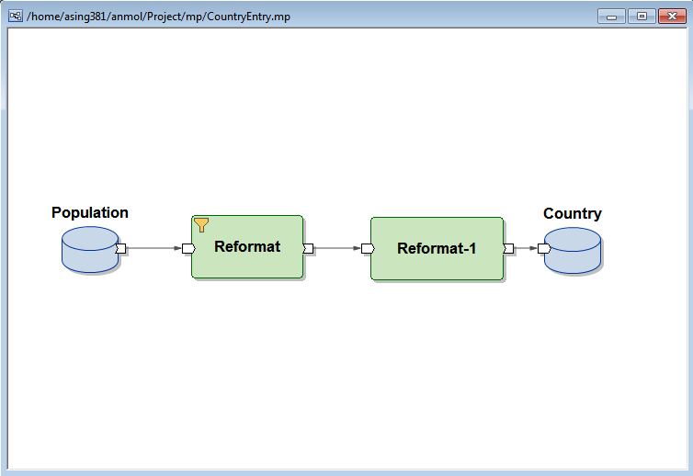
Graph to Extract Countries from Data
It show the Graph containing input
And output file and two reformat.
The purpose of graph is to extract
Country data from the given data.

Slide 4
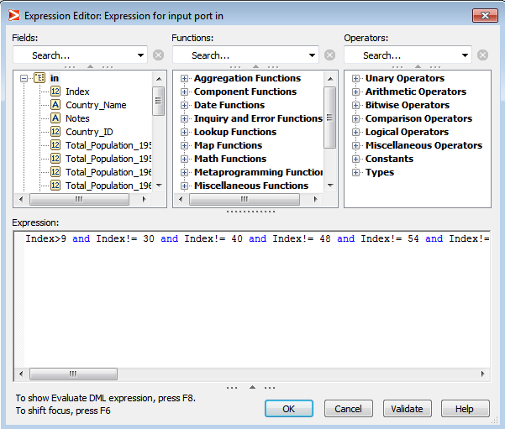
Selection Expression to select Countries
It show the Select Expression to
Select only Country data entries
From the given Data set.

Slide 5
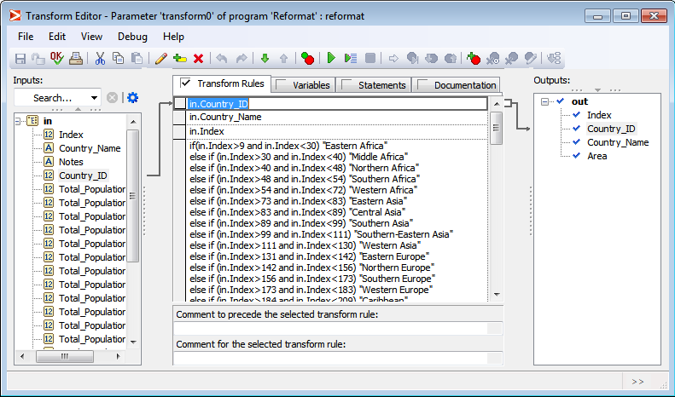
Transformation of Reformat
It show the Transformation to
take only Index, Country_Id ,
Country_Name and Area from
Data set

Slide 6
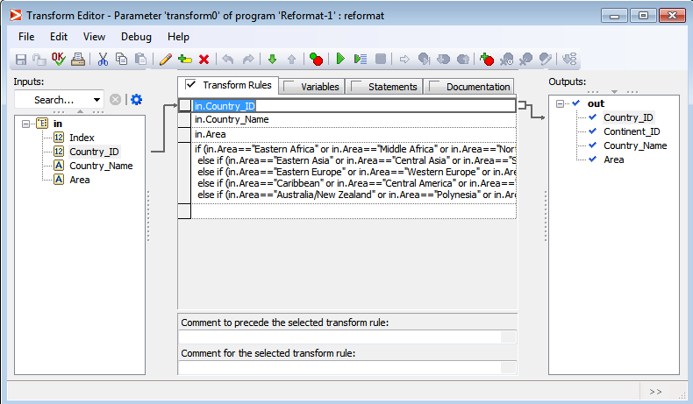
Transformation of Reformat-1
It show the Transformation to
Find the Continent_ID of the
Country

Slide 7
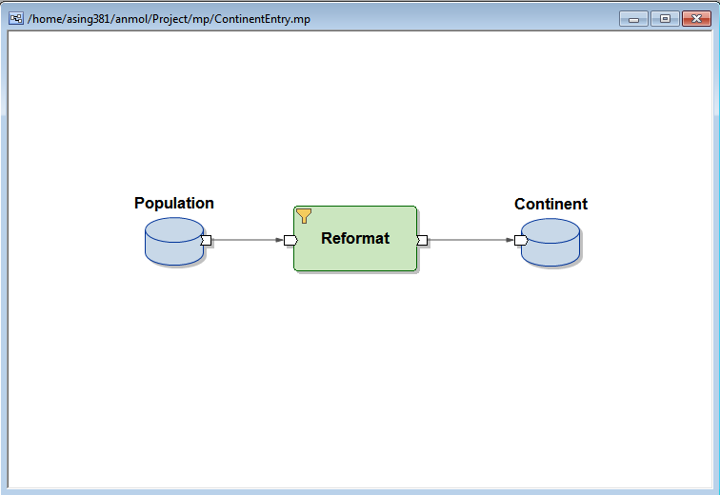
Graph to Extract Continents From Data
It show the Graph containing input
And output file and one reformat.
The purpose of graph is to extract
Continent data from the given data.

Slide 8
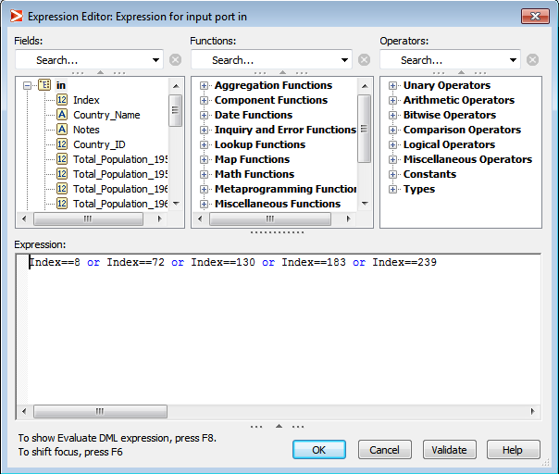
Expression to Select Continent Entries
It show the Select Expression to
Select only Continent data entries
From the given Data set.

Slide 9
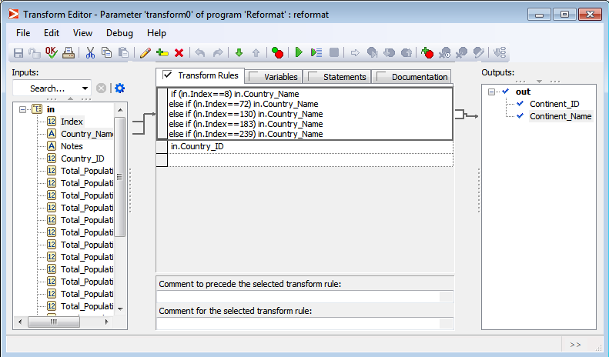
Transformation of Reformat
It show the Transformation to
take only Continent_Id and
Continent_Name from Data set

Slide 10
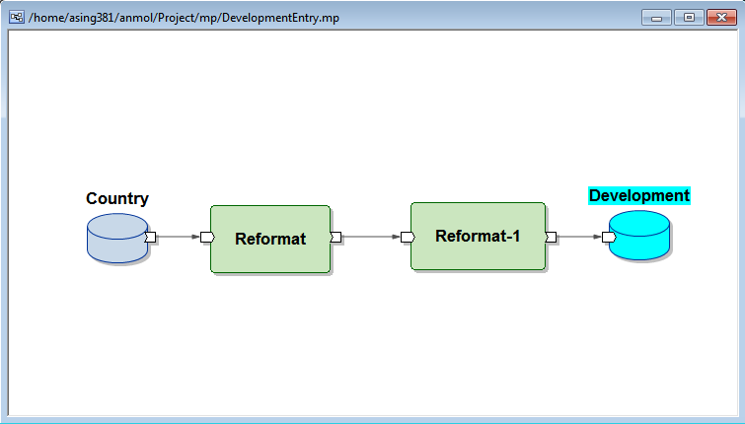
Graph to Extract Development Data
It show the Graph containing input
And output file and two reformat.
The purpose of graph is to extract
development data from the given data.

Slide 11
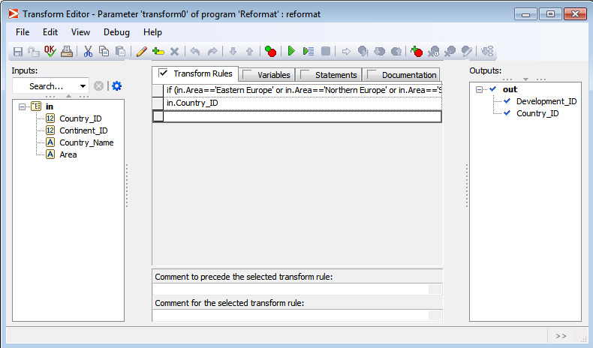
Transformation of Reformat
It show the transformation of
Reformat where Development
ID is set to “1” if category is
More Developed else “2”

Slide 12
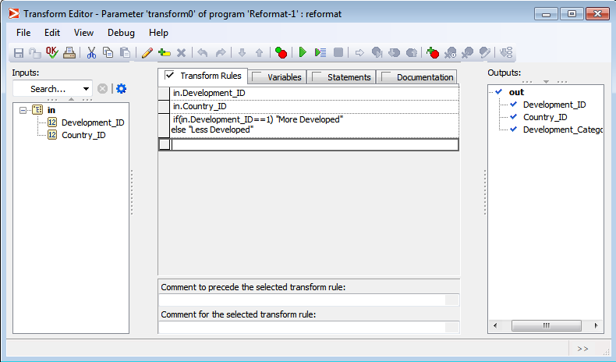
Transformation of Reformat-1
It show the transformation of
Reformat-1 where Development
Category is set to “More developed”
If development_ID is 1 else it give
“Less developed”

Slide 13
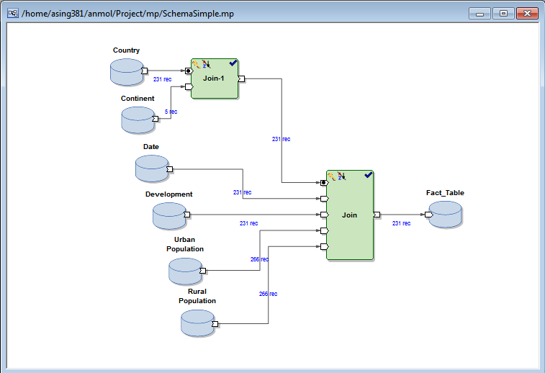
Graph to Create Fact_Table from Tables
The Graph Contain two JOIN and
6 input files. Continent and Country
Tables are joined by “Continent_ID”
Key and they are join with Date,
Development, Urban Population and
Rural Population by “Country ID”

Slide 14
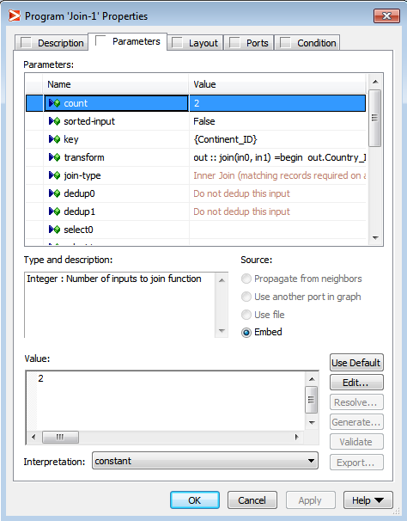
Properties of Join-1
It show the properties of JOIN
Between Country and Continent
Table where “Continet_ID” is given
as Key And sorted-input is set to be False

Slide 15
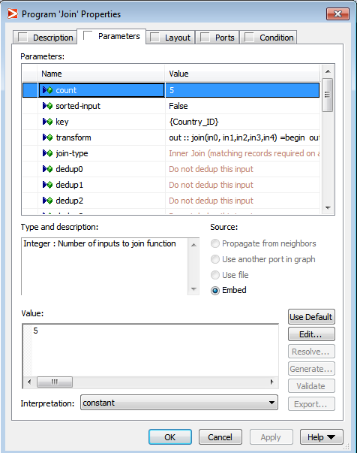
Properties of Join
It show the properties of JOIN
where “Country_ID” is given
as Key And sorted-input is set
to be False

Slide 16
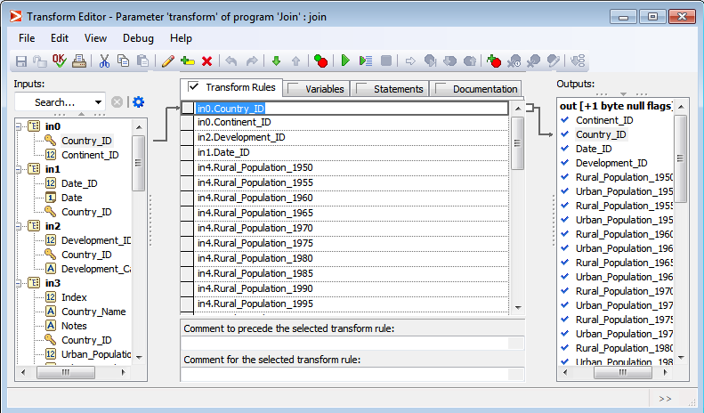
Transformation of Join
It shows the Transformation to take
Specific columns from different Tables

Slide 17
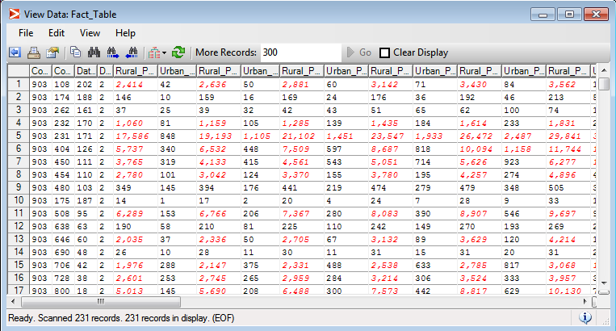
Output of FACT_TABLE
The Output of Fact_Table contains all the Foreign Keys and
the Rural and Urban population of all the countries.

Slide 18
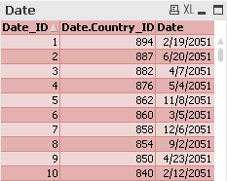
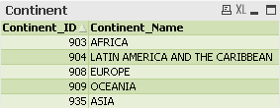
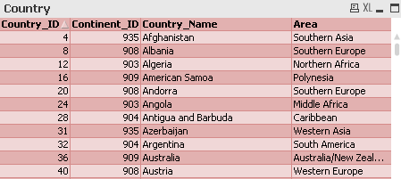
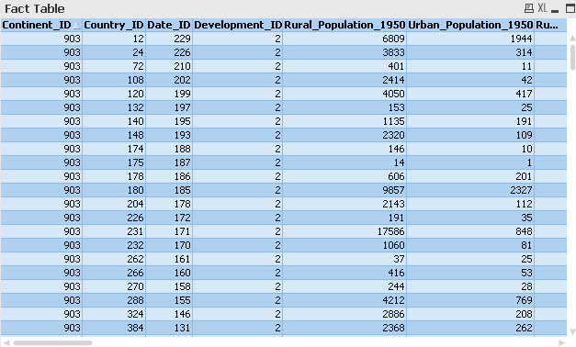
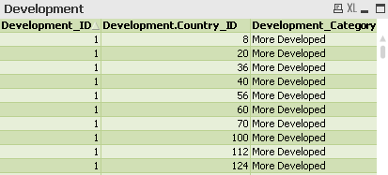
Data tables in qlik view
It shows the different tables which are used to generate Reports

Slide 19
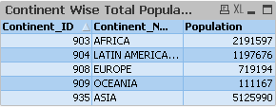
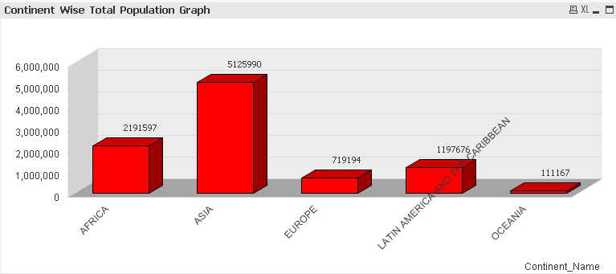
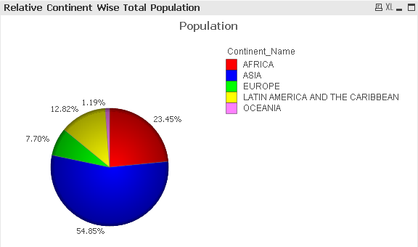
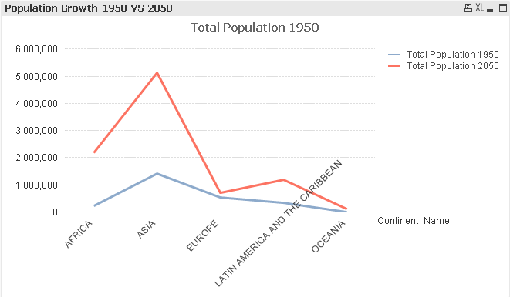
Continent wise total population
The Table showing Continent
Wise Total Population
The Bar Graph showing Continent Wise Total Population
The PIE chart showing Continent Wise Relative Total Population
The Line Graph showing Population Growth between 1950 and 2050

Slide 20
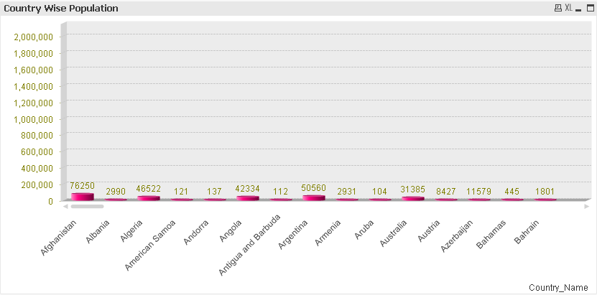
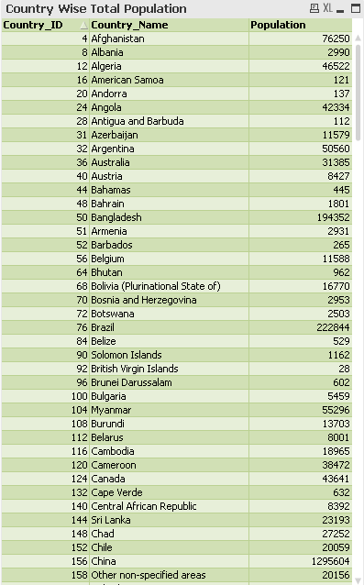
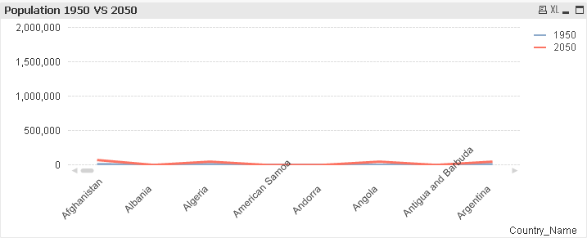
Country wise total population
The Bar Graph showing Country Wise Total Population
The Line Graph showing Population Growth between 1950 and 2050
The Table showing Country
Wise Total Population

Slide 21

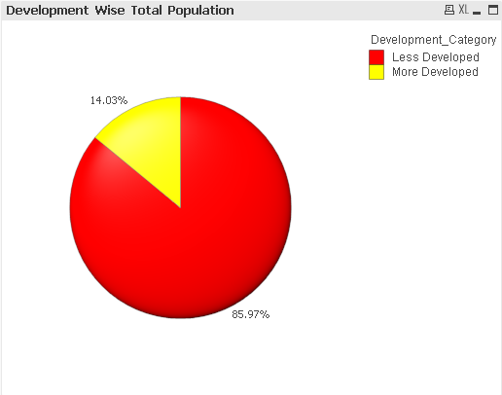
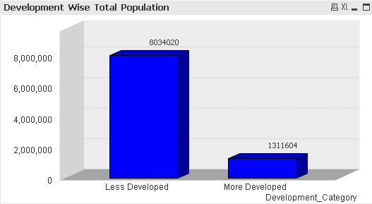
Development wise total population
The Report showing the Development
Category Wise Population
The Report showing the Graph showing Difference
The PIE Chart showing the relative
population between two Categories
between Population of different Categories

Slide 22
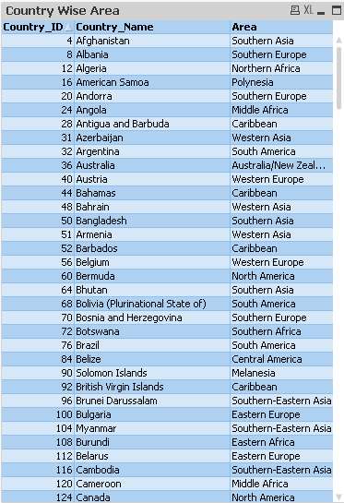
Country wise area
The Report showing the Area to which Country belongs

Slide 23
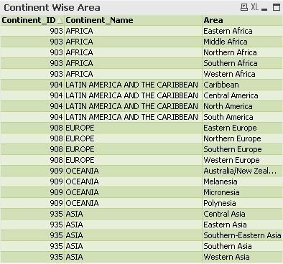
Continent wise area
The Report showing different Areas in the Continents

Slide 24



Country and continent wise highest and lowest population
The Report showing the Country having Highest Population
The Report showing the Continent having Lowest Population
The Report showing the Continent having Highest Population

Slide 25
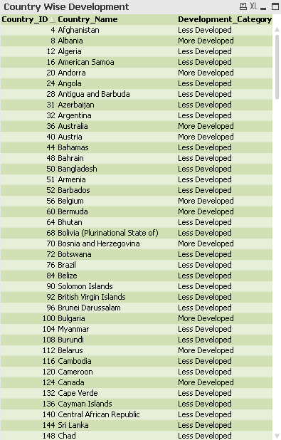
Country wise development
The Report showing the development category for all Countries

Slide 26
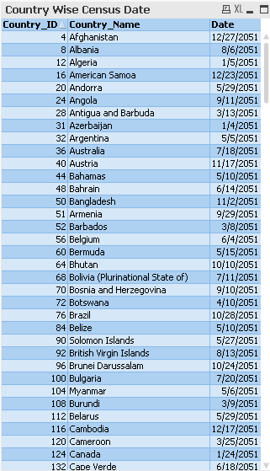
Country Wise census date
The Report showing the census date on which the record was taken for specific Country

Slide 27
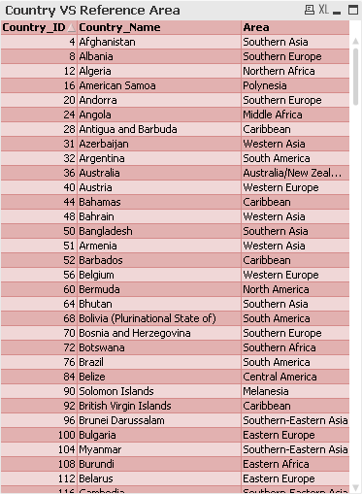
Country VS Reference Area
The Report showing the different area to which the country belongs

Slide 28
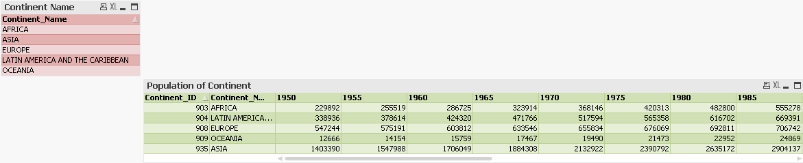
Total population of particular continent in particular year
The Report showing the population of different years of different Continents

Slide 29
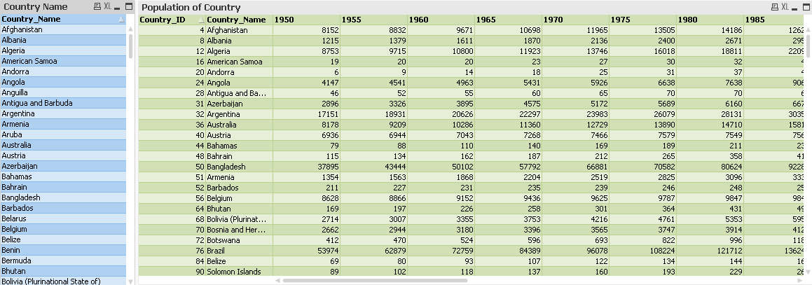
Total population of particular country in particular year
The Report showing the population of different years of different Countries

Slide 30
Thank You

